Slide 1


Faculty Early Career Development (CAREER) Program
Program Solicitation – NSF 17-537
https://www.nsf.gov/pubs/2017/nsf17537/nsf17537.htm
FAQ – NSF 17-050
https://www.nsf.gov/pubs/2017/nsf17050/nsf17050.jsp#q2
CAREER Proposal Writing Workshop
Directorate for Computer & Information Science & Engineering
March 20, 2017
Notes:
Hi, I am Joydip Kundu– Deputy Division Director for Information and Intelligent Systems in NSF’s Directorate for Computer and Information Science and Engineering. We call it CISE. The purpose of this presentation is to provide an overview of the Faculty Early Career Development program, also known as CAREER, and to act as background material for the CAREER Proposal Writing Workshop to be held in March this year.
There are several workshops on the CAREER program. This one is organized by CISE for the CISE community. This is the only such CISE workshop for this calendar year.

Slide 2
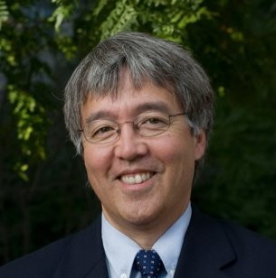
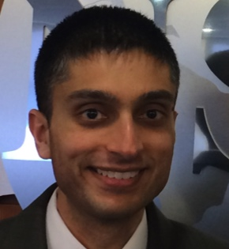

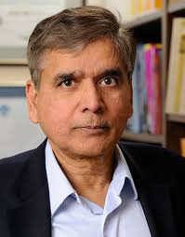
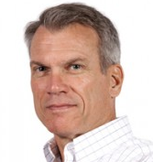
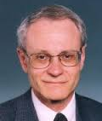
CISE Leadership
CISE Directorate
Jim Kurose, AD
Erwin Gianchandani, DAD
Office of Advanced Cyberinfrastructure (OAC)
Irene Qualters, Office Head
Computing and Communication Foundations (CCF)
Rao Kosaraju, DD
Computer and Network Systems (CNS)
Ken Calvert, DD
Information and Intelligent Systems (IIS)
Howard Wactlar, Acting DD
Notes:
Let me say a few words about the CISE organization. CISE is one of the seven directorates in NSF. Each Directorate is headed by an Assistant Director. For CISE, Dr. Jim Kurose serves as the current Assistant Director. Dr. Erwin Gianchandani currently serves as the CISE Deputy Assistant Director. The CISE directorate includes one Office and three divisions. These are Advanced Cyber Infrastructure, Computing and Communication Foundations, Computer and Network Systems, and Information and Intelligent Systems. The divisions are usually referred by their acronyms as OAC, CCF, CNS and IIS. Each Division is headed by a Division Director and assisted by a Deputy Division Director.

Slide 3
CISE Organization and Core Research Programs
CISE
Office of the Assistant Director
Computing and Communications Foundations (CCF)
Computer and Network Systems (CNS)
Algorithmic Foundations
Communication and Information Foundations
Software and Hardware Foundations
Computer Systems Research
Networking Technology and Systems
Information and Intelligent Systems (IIS)
Cyber Human Systems
Information Integration and Informatics
Robust Intelligence
Advanced Cyberinfrastructure (OAC)
Data
High Performance Computing
Networking/
Cybersecurity
Software
CISE Core Programs
CISE Cross-Cutting Programs
Cross-Foundation Programs
Notes:
Let me elaborate on the CISE organization and the research programs it supports. Each of the four divisions oversees a set of research topics. The boundaries between divisions are distinct for certain research areas while they are blurred for some research topics.
Within each Division, there are a number of clusters - each cluster focuses on a group of related topics, which form the core research program for that cluster. While CCF, CNS and IIS divisions are more focused on fundamental research, the focus of OAC is on infrastructure designed to support transition to practice. For example, in the OAC Data cluster, this means building data infrastructure for archiving, accessibility, and computation by scientific communities.
Cross-cutting programs support research topics that cut across disciplines. We have cross-cutting programs across CISE as well as across NSF. Some examples of cross-cutting programs are Secure and Trustworthy Cyberspace, Cyber-Physical Systems, National Robotics Initiative, Collaborative Research in Computational Neurosciences, and STEM + Computing Partnerships.

Slide 4
NSF Faculty Early-Career Development (CAREER) Program
Most prestigious award to help a junior faculty member develop activities that can effectively integrate research and education within the context of his/her organization.
Notes:
The rest of this presentation is devoted to the CAREER program and proposal preparation for this program.
CAREER is the most prestigious award supporting junior faculty who exemplify the role of teacher-scholars through outstanding research, excellent education and the development of activities that can effectively integrate research and education.

Slide 5
Goals of the CAREER Program
Provide stable support for five years (≥ $400K in most Directorates, BIO and PLR are ≥ $500K)
Allow the career development of outstanding new teacher-scholars in the context of the mission of their organization.
Build a foundation for a lifetime of integrated contributions to research and education.
Provide incentives to universities to value the integration of research and education.
Increase participation of those traditionally underrepresented in science and engineering.
Notes:
The principal goals of the Program are to assist in building a foundation for a lifetime of contributions to research and education; support career development for outstanding researchers as teachers; promote appreciation for integration of research and education in academia and; increase participation of individuals from underrepresented communities in science and engineering. Unlike most other funding opportunities at NSF, CAREER is a 5-year award with a minimum total award of $400,000 for all directorates except the Biological Sciences directorate and the Office of Polar Program under the Geosciences directorate.

Slide 6
CAREER is NSF wide
The program started in 1996
All Directorates/Offices participate in the program
More than 200 Programs across NSF have reviewed CAREER proposals over the years
More than 7,000 CAREER awards have been made over the years
NSF Presidential Early Career Awards for Scientists and Engineers (PECASE) are selected from the pool of CAREER awards
Notes:
The CAREER program is NSF wide, that is all Directorates and Research Offices participate in this program. Since the program’s debut in 1996, over 200 NSF programs have made more than 7,000 CAREER awards. The prestigious NSF Presidential Early Career Awards for Scientists and Engineers are selected from the pool of CAREER awardees.

Slide 7
Faculty Early Career Development (CAREER) Program (NSF 17-537)
Next Deadlines:
July 19, 2017 – BIO, CISE, EHR
July 20, 2017 – ENG
July 21, 2017 – GEO, MPS, SBE
Future Years:
Third Wed, Thursday, Friday of July
IMPORTANT INFORMATION AND REVISION NOTES
Eligibility requirements have been revised to clarify the required early-career status of applicants.
Support for senior personnel other than the PI that is commensurate with a limited collaborative role in the project is now allowed in the budget of the proposal or of a sub recipient.
Notes:
The recently released CAREER solicitation has a few changes from the previous years.
First, eligibility criteria have been revised to clarify the required early-career status of applicants.
Second, support for Senior personnel other than the PI that is commensurate with a limited collaborative role in the project is now allowed in the budget of the proposal or of a sub recipient.

Slide 8
CAREER Investigator Eligibility
Hold a doctoral degree in a field supported by NSF by proposal deadline
Be employed in a tenure-track (or equivalent) position at an eligible institution as an Assistant Professor (by October 1 following deadline)
Have educational responsibilities at the eligible institution
Have not previously received a CAREER award
Have not had more than two CAREER proposals reviewed
Notes:
I will talk about PI and institution eligibility criteria in the next three slides. Let me start with PI eligibility. You are eligible to apply to the CAREER program, if you meet ALL of the following criteria.
1. You hold a doctoral degree in a field supported by NSF by the proposal deadline
You are employed in a tenure-track (or equivalent) position at an eligible institution as an Assistant Professor by October 1 following the deadline. You should not submit a CAREER proposal if you anticipate that your title will change to Associate Professor (either tenure-track or tenured) on or before the October 1st following the proposal submission deadline.
You have educational responsibilities at the eligible institution.
You have not previously received a CAREER award from NSF.
4. You have not had more than two CAREER proposals reviewed by NSF. In other words you can apply at most three times to this program.

Slide 9
Tenure-Track Equivalency
The employee has a continuing appointment that is expected to last the five years of a CAREER grant;
The appointment has substantial research and educational responsibilities;
The proposed project relates to the employee's career goals and job responsibilities as well as to the mission of the department or organization.
The Departmental Letter must affirm that the investigator's appointment is at an early-career level equivalent to pre-tenure status, and the Departmental Letter must clearly and convincingly demonstrate how the faculty member's appointment satisfies all the above requirements of tenure-track equivalency.
Notes:
For a position to be considered a tenure-track-equivalent position, it must meet all of the following requirements:
The employee has a continuing appointment that is expected to last the five years of a CAREER grant;
The appointment has substantial research and educational responsibilities;
The proposed project relates to the employee's career goals and job responsibilities as well as to the mission of the department or organization.
As stated in the Proposal Preparation Instructions, the Departmental Letter must affirm that the investigator's appointment is at an early-career level equivalent to pre-tenure status, and the Departmental Letter must clearly and convincingly demonstrate how the faculty member's appointment satisfies all the above requirements of tenure-track equivalency.

Slide 10
Institutional Eligibility
Academic institutions in the U.S., its territories or possessions, and the Commonwealth of Puerto Rico that award degrees in fields supported by NSF
Non-profit, non-degree-granting organizations such as museums, observatories or research labs may also be eligible to submit proposals, if the eligibility requirements of the PI's position are satisfied
NSF encourages proposals from different institutional types, including Minority Serving and Undergraduate Institutions
Notes:
Here are the criteria for institutional eligibility. You may notice that these are quite inclusive. You may apply to the CAREER program if you satisfy individual eligibility criteria and you are employed in an academic institution within the United States including Puerto Rico. Also, non-profit, non-degree-granting organizations such as museums, observatories or research labs may also be eligible to submit proposals. Additionally, NSF encourages proposals from different institutional types, including Minority Serving and Undergraduate Institutions.

Slide 11
CAREER varies across NSF
Numbers of submitted CAREER proposals vary widely across NSF
Review and funding methods vary according to Directorate and Division practices
CAREER proposals compete with other research proposals in the most appropriate research program
Notes:
The number of CAREER proposals submitted to NSF varies widely across the various participating programs. This number typically reflects the size of the research community served by each program, and the number of new PIs that come through the academic pipeline in these communities. Accordingly, the review processes and the funding methods vary.
When you submit a CAREER proposal, your proposal will be reviewed in the research program that best fits your proposal.

Slide 12
Merit Review of CAREERs
CISE, EHR, ENG: Mostly dedicated CAREER Panels
BIO, SBE and most of GEO: Ad hoc + Panel (ATM uses ad hoc only)
MPS: varies by Division
Notes:
Each Directorate uses different reviewing methods for CAREER proposals. CISE uses dedicated expert panels to review CAREER proposals.

Slide 13
Expectations
CAREER proposals are submitted to a disciplinary unit or program
They are reviewed according to the relevant Program guidelines - Talk to Program Officer or Division Contact for more information (http://www.nsf.gov/crssprgm/career/contacts.jsp)
Make sure to check on typical award sizes in your program
Ask about expectations for scope of research and education plans
Notes:
Each CAREER proposal is submitted to a specific program, and is reviewed according to the guidelines of that Program. If you are wondering whether a specific program will be a good fit for your proposal, please contact the CAREER Division contact, or any Program Officer responsible for that program. As mentioned before, practices vary across Divisions, and therefore, it is always a good idea to check with the appropriate program officer who might be handling your proposal, before you submit. For inter-disciplinary proposals where the choice of program is not clear, please talk to all Program Officers who might have some interest in the topic to find the suitable home for the proposal.
In addition to suitability, you should ask about the typical award sizes in that program for CAREERs and expectations from that program in terms of research scope and education plans that span the entire duration of the CAREER award.

Slide 14
Notes:
This slide shows the total number of CAREER proposals submitted to various directorates at NSF over the past 10 years. You can see that the numbers vary across different Directorates. Within CISE, there has been a decrease in the number of submissions over the past 5 years.

Slide 15
Notes:
This chart shows the percentage of submitted proposals that have been funded. The numbers vary between years and across directorates. Within CISE, the overall CAREER funding levels has largely remained constant, and the increase in funding rates from 20% to near 25% can be attributed to a decline in the number of submissions. Please do note that there was a bump in funding in 2009, because of the availability of fiscal stimulus funds, and these awards expired last year.

Slide 16
Are you ready for CAREER?
Can you think of a proposal that is appropriate for NSF with research and education activities that are innovative, ambitious and consistent with a five year duration?
Is your Department/Organization supportive?
Are you committed to the goals of CAREER?
Are you at the right stage in your career?
Have you discussed your ideas with mentors, program officers, and other appropriate individuals?
Notes:
Now, let’s talk about if submitting a CAREER proposal at this time is the right step for you. A good CAREER proposal supports a comprehensive research and education plan spanning 5 years, with a University or Department that supports continuous faculty development. I already discussed the pre-requisites for being eligible – see the solicitation for details. We hope that you have discussed your research and education plans with your mentors, as well as NSF program officers.

Slide 17
What should be in a CAREER proposal?
A compelling research plan
Innovative but doable education plan
A plan for the effective integration of both sets of activities
Notes:
Once you have decided that you are ready to submit a CAREER proposal, and you have identified the right program to submit to, let’s discuss what should be in the proposal. A compelling research plan is the core of any successful NSF proposal, and the CAREER program is no different. However, note that this is single-PI proposal spanning 5 years, and your research plan should demonstrate your ability to conduct innovative research over this time-span on your own.
In addition, another vital component of a CAREER proposal is a solid education plan. You also need to provide an effective plan that integrates the process and outcomes of your research into your education activities.

Slide 18
CAREER Education Plan
Education activities – e.g. curriculum, pedagogy, outreach, mentoring at any level, majors and non-majors, teacher preparation or enhancement, K-12 students, and/or the general public.
Activities should go beyond what is expected from any Assistant Professor in your field
Should be informed by what has been successful in the past – intellectual merit of the education component
Should have a plan for assessing the success of the education program
Notes:
Education plans can cover a broad spectrum of activities, and the solicitation goes into specific examples of such activities. What we would like to see is an education plan that is customized to your abilities, using the resources that your location and institution provide, and that serves the needs of the student community in and around your institution. This plan should be consistent with best practices in curriculum, pedagogy and evaluation, and it should support integration of your research outcomes. A good evaluation plan goes a long way towards convincing reviewers of the efficacy of your education plan, so please consider that while you develop your proposal.
We strongly suggest that on your website, you include a page on education and outreach.

Slide 19
Integration of Research and Education
How will your research impact your education goals and how will your education activities feed back into your research?
Involving others (graduate, undergraduates, K-12, high school teachers, public) in your research using new tools, laboratory methods, field components, web outreach, cyber networks, etc...
Partnering with those in other communities, especially those traditionally underrepresented in science and engineering
Bringing the excitement of your research topics to help in the education of others
Searching for new methods to deliver your research results to a broader audience than those in the immediate research community
Using the broader community to gather and analyze data for your scientific pursuits (“citizen science”)
Notes:
This slide provides examples of activities appropriate for a CAREER proposal.
Educational plans should be “actionable”, and by that we mean you should provide evidence of your commitment to act on your plans, not just provide promises.
For example if you say you plan to engage in K-12 activities, you should already have contacted the target schools to gain permission and buy-in for these activities.
Simply promising to engage students from under-represented groups is not sufficient. If you propose to partner with organizations or schools that represent or serve these students, you should already be actively engaged in this.
As an innovative approach to broader impact, you might, for example, take advantage of emerging opportunities to reach large groups of people through social media to provide new avenues for informing the general public of exciting research and its results.
The same opportunity allows you to be innovative in how you conduct research, for example, by using crowdsourcing and creating or following new rigorous research methodologies.

Slide 20
CAREER Personnel and Budgets
No co-principal investigators are allowed
Consultants and senior personnel costs are allowed in sub-awards commensurate with a limited collaborative role in the project NEW!!!
Some programs will support buy out of academic year time for teaching-intensive institutions (check with your Program Officer)
Support for education plan may be requested
International activities are encouraged and may be supported by the Office of International Science and Engineering (OISE)
Notes:
CAREER proposals and awards are “single investigator” awards featuring the independent thinking of early career faculty, so no co-PIs are permitted.
Support for consultants or senior personnel other than the PI that is commensurate with a limited collaborative role in the project is now allowed in the budget of the proposal or of a sub recipient.
You may be able to use CAREER funds to buy out of academic year teaching, especially if your teaching load is heavy, to enable time to conduct research supported by a CAREER award. Please discuss this with your program officer before submission.
Also discuss with your program officer how your CAREER funds might support the education portion of your work.
For example, you might fund an expert in education assessment to evaluate the success of your education approach.
NSF encourages CAREER PIs to include international/global dimensions in their projects. If an international component is included, proposers are encouraged to contact the relevant country program officer in the Office of International Science and Engineering. See the CAREER solicitation for details.

Slide 21
Letter(s) of Collaboration
Project Description or Facilities, Equipment and Other Resources must document the nature of all project collaborations, such as:
    Intellectual contributions to the project
    Permission to access a site, use instrumentation or facility
    Offer to furnish samples / materials for research
    Logistical support / evaluation services
    Mentoring of U.S. students at a foreign site
Letter should contain a single-sentence statement of collaboration:
    “If the proposal submitted by Dr. [name of the PI] entitled [proposal title] is selected for funding by the NSF, it is my intent to collaborate and/or commit resources as detailed in the Project Description.”
    Must NOT recommend or endorse PI or project
Notes:
The nature of collaboration including intellectual contributions to the project, access to facilities, etc. should be described in Project Description or Facilities, Equipment and Other Resources sections of the proposal.
Letter(s) of Collaboration should contain a single-sentence statement of collaboration as per proposal preparation instructions.

Slide 22
Departmental Letter (2 pages)
    Support for the PI’s proposed CAREER research and education activities
    Relationship between the PI’s career goals and job responsibilities and that of the department
    Commitment to the professional development of the PI with mentoring and support for the PI’s efforts to integrate research and education
    Verification that the PI is eligible for the CAREER program
    Demonstrate how the faculty member's appointment satisfies all the requirements of tenure-track equivalency (if applicable)
Notes:
CAREER proposals require a letter, up to 2 pages in length, from the department chair to show support for the PI’s CAREER research and education activities and include:
An acknowledgement of institutional commitment to the professional development and mentoring of the PI in both research and education.
This letter is the appropriate place to indicate a willingness, if present, by the department to reduce the teaching load as part of the commitment to foster research and the PI’s career or to allow the PI to buy out teaching time to foster research in an institution where the teaching load is heavy.
The department chair must verify that the PI is eligible for the CAREER program at the time of the proposal deadline.
The Departmental Letter must affirm that the investigator's appointment is at an early-career level equivalent to pre-tenure status, and the Departmental Letter must clearly and convincingly demonstrate how the faculty member's appointment satisfies all the requirements of tenure-track equivalency.
The letter should be signed by the Head of those Departments responsible for the PI’s tenure or tenure-track appointment.

Slide 23
Traits of Successful CAREER Proposals
CAREER proposals should match the expectations in the disciplinary programs in terms of research and education - This is a highly competitive program!
Written with peer reviewers (Ad Hoc and/or Panel) in mind - Ask your Program Officer what types of reviewers will be assessing your proposal
Appropriate scope of education and research activities. It is a 5-year plan, not your whole life
Goes outside the education box of regular research proposals in your field
Strikes a balance between doable research activities and more risky pursuits
Notes:
Highly Competitive proposals tend to
address an important open research problem (which maybe well-known or new), and
offer a novel approach and a solution that is better by some measure over current solutions,
where a better solution would make a significant difference to the field and/or society
In addition to a high-quality research plan, a good education plan is necessary. A proposal that might be deemed Highly Competitive for its research component might not be funded if the educational component is weak.
The proposal should be well organized and easy to read and the problem and solutions should be well described so that they are clear to a set of reviewers in your area.
The scope of a CAREER proposal is a “Goldilocks” problem: it should be neither too small (doable in two years, say) or too big (needing 10 years, say). Scope the research problem so that there is meaningful work for a PI with one or two graduate students for five years. (Think of the number of dissertations that could be carried out given the problem statement.)
Let me reiterate that the education plan requires more than just including the research in a class or other standard education activities expected by a faculty member.
NSF funds innovative, high-risk, high payoff proposals. Successful proposals often show preliminary results that inform the review panel that the research is apt to succeed, but not so much work that the panel feels the “work has already been done”.

Slide 24
PECASE: Presidential Early Career Awards for Scientists and Engineers
PECASE Eligibility - Be a U.S. Citizen or Permanent Resident by the time of agency nomination
Nomination by agency, not application by individuals
20 Nominees from NSF every year from the pool of recent CAREER awardees
Number of nominees per Directorate is a function of the number of proposals submitted to the program for each Directorate
Notes:
The Presidential Early Career Awards for Scientists and Engineers “recognize and honor outstanding scientists and engineers at the onset of their independent research careers.”
CAREER awardees who are US citizens or permanent residents are eligible to be nominated by NSF for an award. Approximately 20 NSF CAREER awardees are selected each year by the White House to receive the award.
The number of nominees per Directorate is determined by the relative number of CAREER proposals submitted to the Directorate each year.

Slide 25
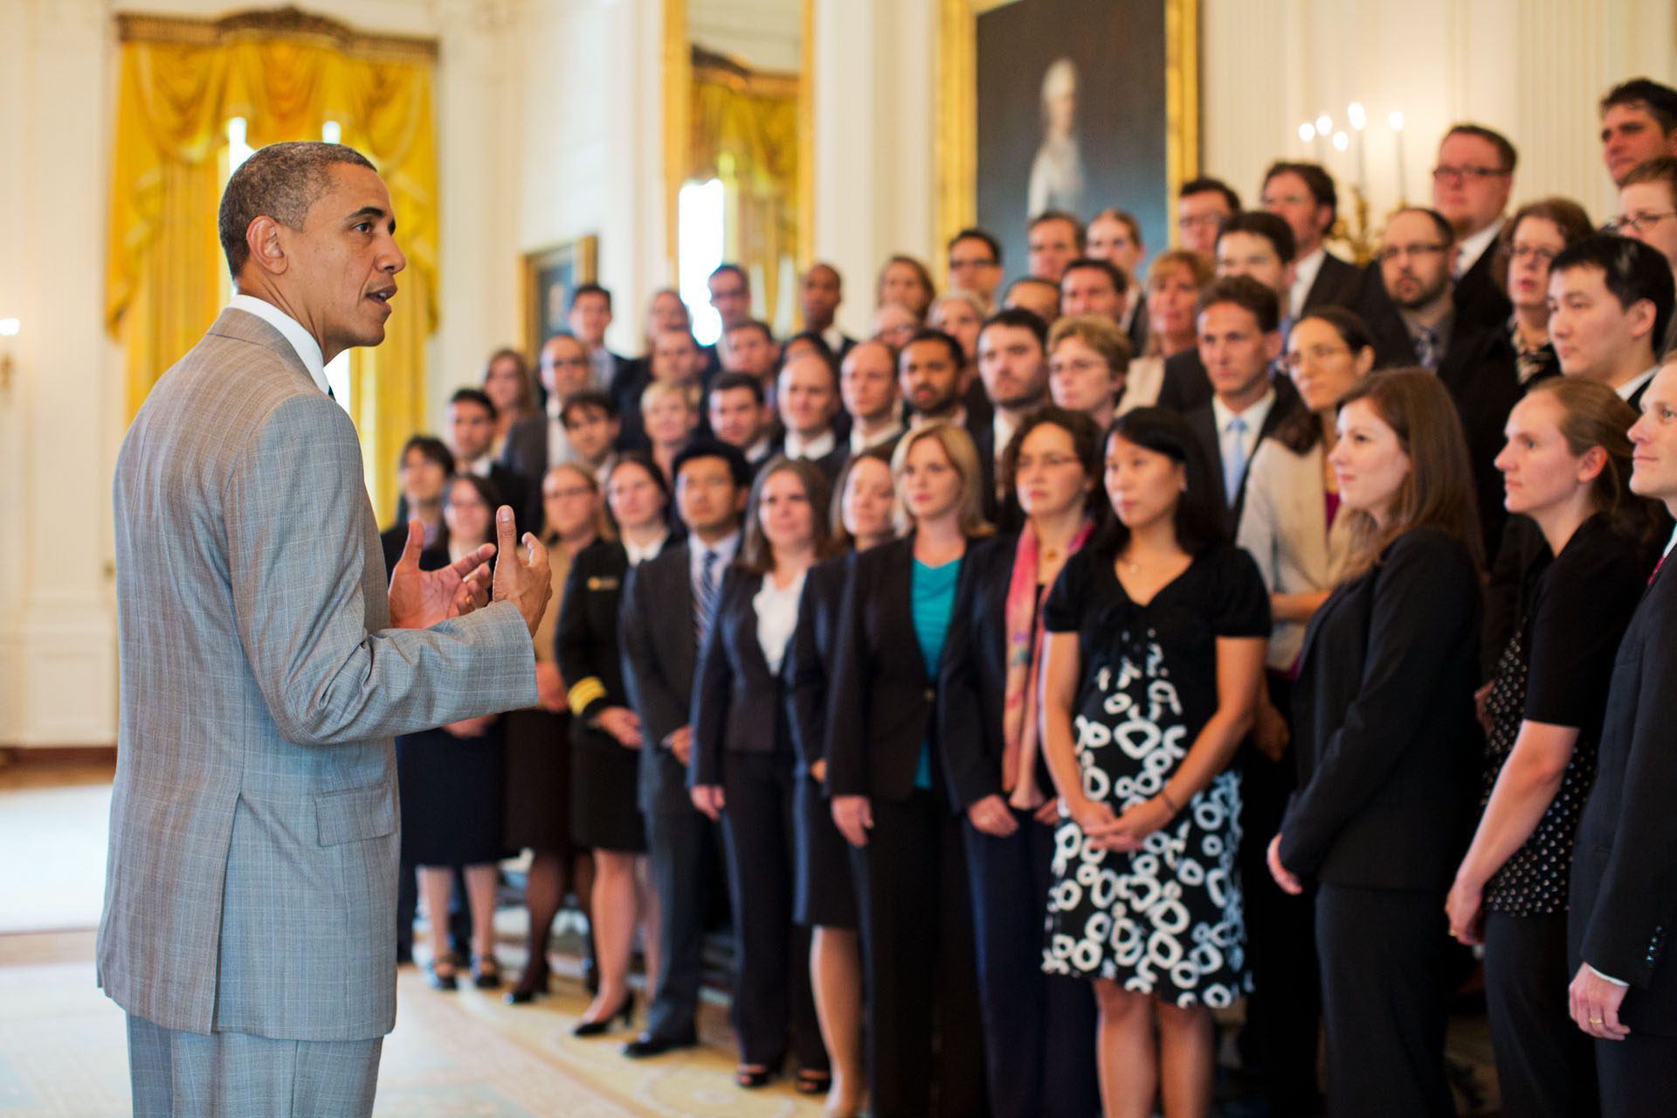
PECASE: Presidential Early Career Awards for Scientists and Engineers
Notes:
Winners are honored in a White House ceremony, attended by the President, whenever possible, and by the head of the Office of Science and Technology Policy. This is a photo of the most recent group of winners; they met with President Obama and OSTP director, John Holdren.

Slide 26
CAREER Award Supplement Opportunities
Notes:
Now let me tell you about a few award supplement opportunities.

Slide 27
Career-Life Balance Initiative (CLB) Supplement
Encourages career-life balance opportunities such as flexible start dates for NSF awards
NSF also invites the submission of supplemental funding requests to support additional personnel (e.g., research technicians or equivalent) to sustain research when PIs are on family leave.
Up to 3 months of salary support may be requested (for a maximum of $12,000 in salary compensation) through the CAREER program.
For additional information, please contact the appropriate Directorate or Divisional representative identified on the CAREER webpage at: http://www.nsf.gov/crssprgm/career/contacts.jsp.
Notes:
Introduced in 2012, NSF's Career-Life Balance (CLB) Initiative is a ten-year initiative to build on the best family-friendly practices among individual programs and expand them agency-wide.
The goal is to clear the obstacles from STEM Career-Life pathways from graduate education through to full professorship. To help to reduce the rate at which women depart from the STEM workforce, the initiative initially focuses on dependent-care issues such as child birth/adoption and elder care for NSF's CAREER and postdoctoral programs.
An NSF CAREER grant can have a flexible start date and no cost extension if needed. A PI is then able to adjust the project duration if needed.
NSF can provide supplemental funding to support additional personnel (e.g., research technicians or equivalent) to continue the project when the PI is on family leave. For a career awards, such supplemental funding can be up to $12,000.

Slide 28
Research Opportunities in Europe for NSF CAREER Awardees - Supplement
Agreement between NSF and the European Union (EU )
Signed on July 13, 2012; update in February 2015.
Enables CAREER awardees to pursue research collaboration with European colleagues supported through EU-funded European Research Council (ERC) grants.
ERC Executive Agency (ERCEA) identifies ERC-funded research groups who wish to host CAREER awardees for research visits of up to one year within their ERC funding.
In general, the European hosts will provide living expenses during the visit and NSF will provide travel support
Notes:
To promote international collaboration, NSF signed an agreement with the EU to enable US young researchers with NSF Career awards to pursue research collaborations with European colleagues supported through EU-funded ERC grants. Essentially, NSF will provide travel support and the European hosts can provide up to one year living expenses within their ERC funding.

Slide 29
The CAREER website – www.nsf.gov/career
Latest Program Solicitation - NSF 17-537
Frequently Asked Questions (for submission years 2015 and 2016) - NSF 15-057
CAREER Directorate/Division Contacts
Link to PECASE awards
Next Deadlines for 2017:
  July 19 - BIO, CISE (OAC, CCF, CNS, IIS), EHR
  July 20 - ENG
  July 21 - GEO, MPS, SBE
Notes:
My talk has only covered some parts of NSF career program. More information about the NSF career program can be found from the career web site: www.nsf.gov/career
This includes:
the latest career program solicitation: NSF 17-537;
Frequently asked questions: NSF 15-057,
CAREER Directorate/Division contacts and
Link to the Presidential Early Career Awards for Scientists and Engineers.
The next deadlines for the career program are in July, 2017. Different Directorates may have deadlines on different dates. The current deadline for the CISE Directorate is on July 19, 2017. Please note that this is a new solicitation for the CAREER program. Major changes include
A revision of eligibility requirements to clarify the required early-career status of applicants and
The allowance of support for senior personnel other than the PI that is commensurate with a limited collaborative role in the project
in the budget of the proposal or of a subrecipient.

Slide 30
Follow-up Questions?
Notes:
If you have further questions about the NSF career program, please bring them up at the CISE CAREER workshop in March in Arlington. You can also contact NSF program officers through email, phone, or in person. We will try to answer your questions and update the Frequently Asked Questions if needed. Thank you for your attention.

